Slide 1
A Guided Tour
District 7930
Presidents-Elect
April 16, 2014
Notes:
I’m happy to be here today to provide tour of Rotary Club Central – our relatively new online goal-setting and tracking tool. It’s important for every club to learn how to use this tool to better manage and improve their club operations.

Slide 2
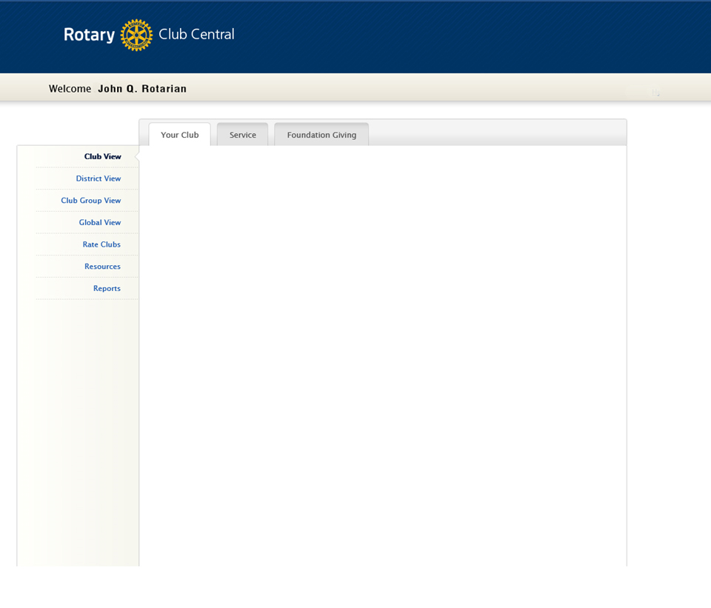
Walk Through of Rotary Club Central
Workshop – Navigating / Entering Goals
Notes:
Today, we will review the whole system for Club operations (CLICK)
And, then we’ll have a bit of time for some hands-on work on your own sites. (CLICK)
(CLICK)

Slide 3
Why Club Central?
Consolidate data in one location
Eliminate paper
Foster continuity in leadership
Create transparency
Central service project database
Notes:
It’s important to understand why Rotary created Club Central in the first place. (CLICK)
First, Club Central pulls together all the data that was previously only available from several different reports. (CLICK)
Second, replaces paper forms for membership and Rotary Foundation goals as well as the Planning Guide for Effective Clubs. (CLICK)
Third, It fosters continuity in club planning by providing each incoming leader with a data track of previous years. (CLICK)
Fourth, it promotes transparency in that all club members can view their club goals and progress. (CLICK)
And fifth, it allows the creation of a central Rotary database for service projects – something we’ve never had before. (CLICK)
(CLICK)

Slide 4
Who can set goals at the Club level?
President
Secretary
Treasurer
Membership Chair
Foundation Chair
President-Elect - for planning period
for year of service
Notes:
So, who can operate this system at the Club level?
Five officers have access to input goals and progress reports - (CLICK) the President, (CLICK) Secretary, (CLICK) Treasurer, (CLICK) Membership Chair and (CLICK) Foundation Chair – (CLICK) for the year of service in which they hold those jobs.
Also, (CLICK) the President-Elect has access to input goals for his or her presidential year as soon as they are registered as an incoming president in the RI database.
(CLICK)

Slide 5
Getting there directly:
www.rotary.org/clubcentral
Notes:
There are multiple ways to get to Club Central. The most direct is at the web address www.rotary.org/clubcentral
(CLICK)

Slide 6
Notes:
But it is also available to every Rotarian via their My Rotary page. (CLICK)

Slide 7
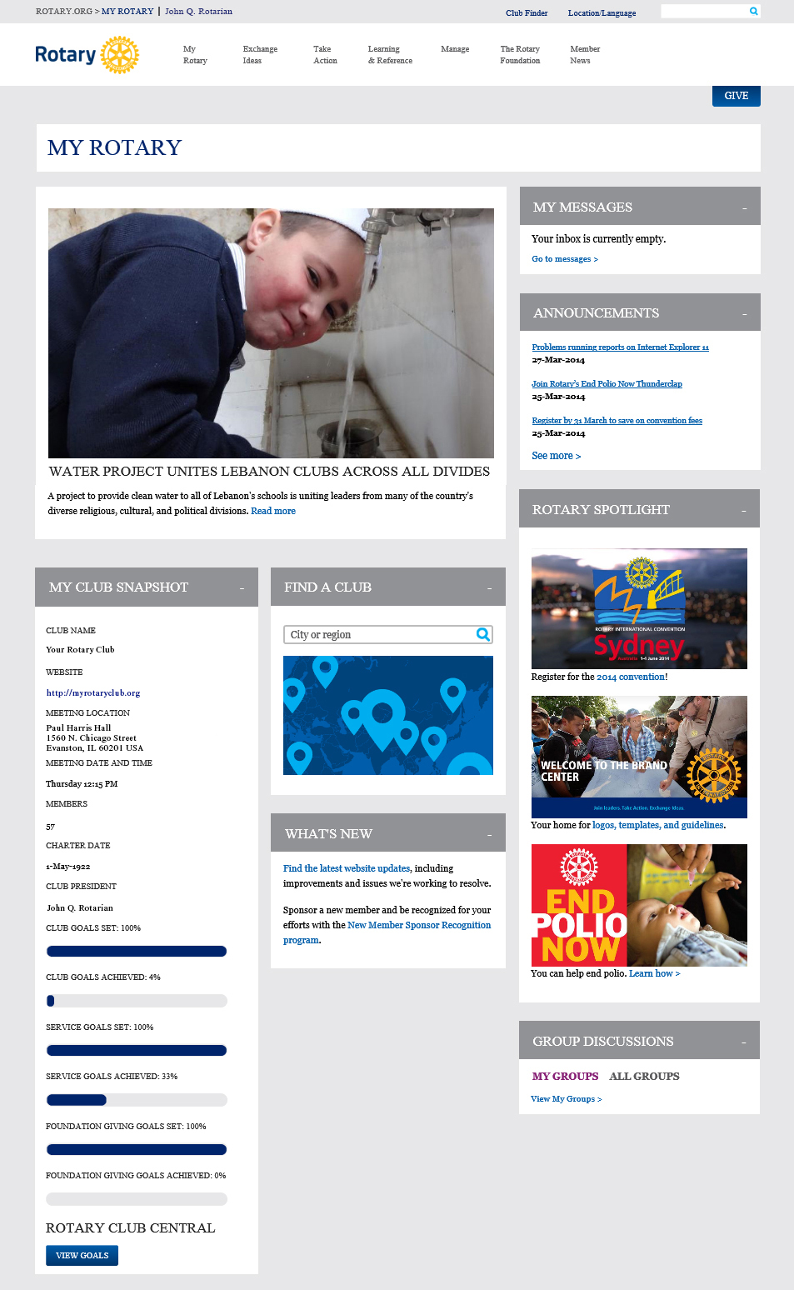
Notes:
Here’s a pull-back view of the whole My Rotary page. (CLICK)
On the lower left is a column called My Club Snapshot (CLICK)
(CLICK)

Slide 8
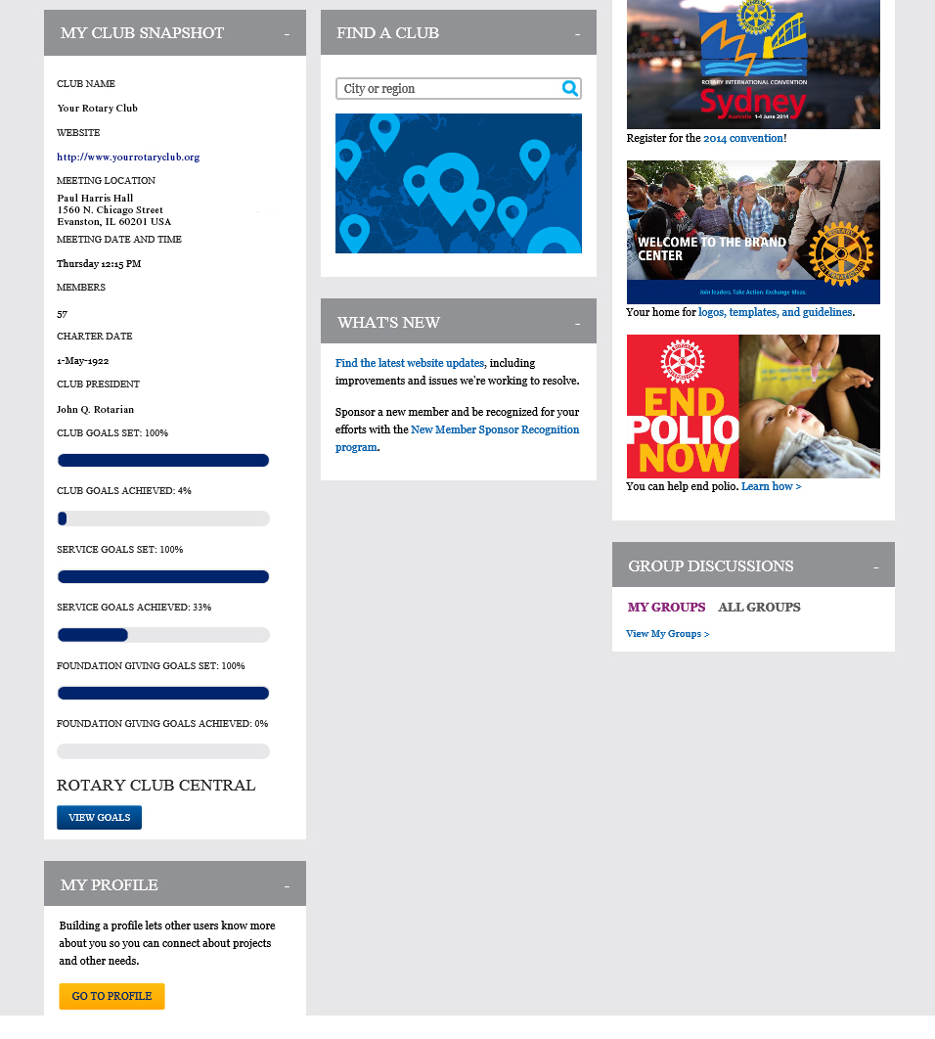
Notes:
Here’s a close-up of the Club Snapshot area which contains some basic information about your club (CLICK)
plus some data about club goals that comes from Club Central. This information is on every club member’s page (CLICK)
At the bottom of this column is a link to Club Central where, again, every member can see the full detail of the club’s goals and progress. (CLICK)

Slide 9
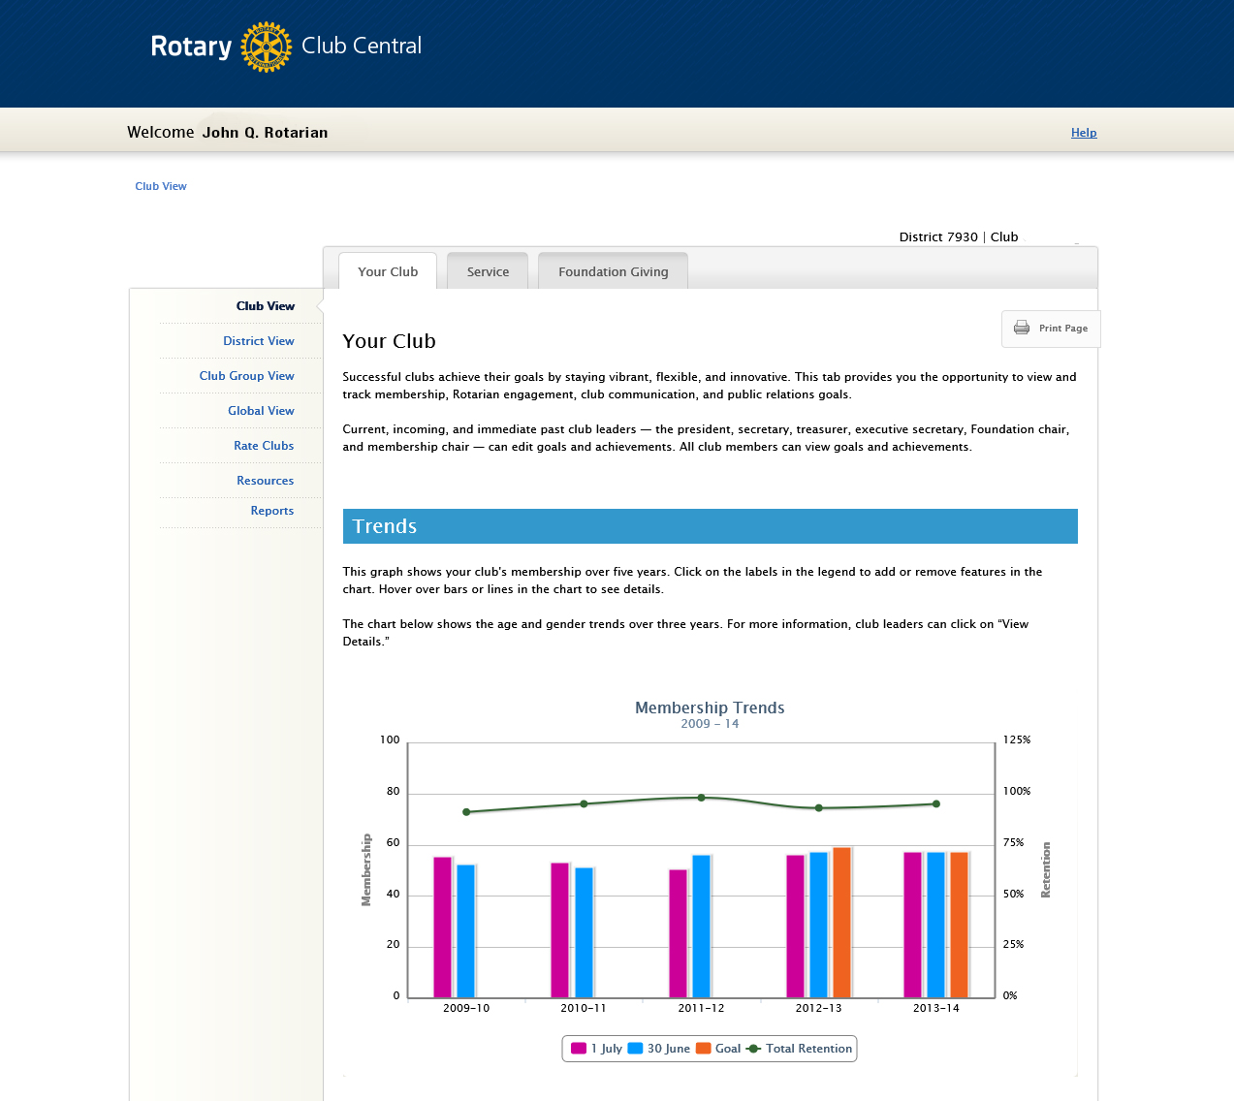
District: 0000 | Club: Your Club
Notes:
When you go to Club Central, this is the default view for all Rotarians. (CLICK)
On the left side are different views of the data. Today, we’ll focus on the Club View, but there are also District view , a Global worldwide view and some additional resources in this column. (CLICK)
Across the top are three category tabs for the data and planning of Club Central – Your Club, which deals primarily with membership, Service, which deals with club projects and activities and Foundation Giving, which tracks and plans for various foundation categories. (CLICK)
Today, we’ll be looking exclusively at the Club View. And when every Rotarian comes to Club Central, this is what they’ll see by default: the Club View and Your Club tab for the club in which they are a member. Even the President of RI sees this page for his or her club when they come here.
On this first screen, you’ll see a 5-year track of your membership goals and actuals, but there’s lots more to scroll down to. Let’s pull back and take a look at the whole page on this Your Club tab. (CLICK)

Slide 10
Club View / Your Club Tab
Trend Data
Membership history, goals & retention
Age and gender history
Goals and Progress
Membership and retention
Rotarian engagement
Club communications
Public relations
Notes:
Here’s a pull back view of the sections on the whole tab. (CLICK)
There is Trend data about your membership at the top. (CLICK) (CLICK) (CLICK)
Then four sections for you to input your Membership goals and progress. (CLICK) (CLICK) (CLICK) (CLICK)
(CLICK)

Slide 11
District: 0000 | Club: Your Club
Notes:
Now let’s go back to the top of this starting page where you’ll see a graph of membership levels and retention percentages for the last five years. (CLICK)

Slide 12
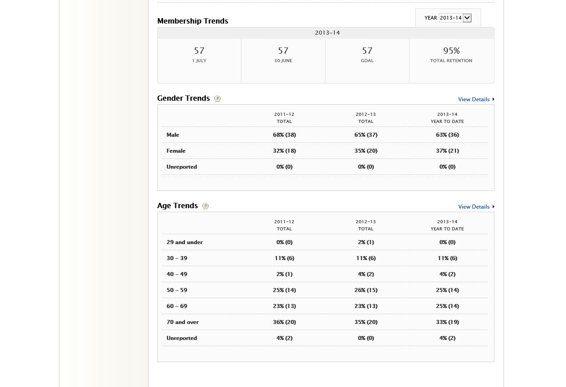
District: 0000 | Club: Your Club
Club Trends Tracking
Data from RI
Notes:
Scrolling down you will the detailed membership data for 5 years on membership totals and retention and 3 years on membership gender and age. (CLICK)
RI populates these data fields from their database of your members. (CLICK)

Slide 13
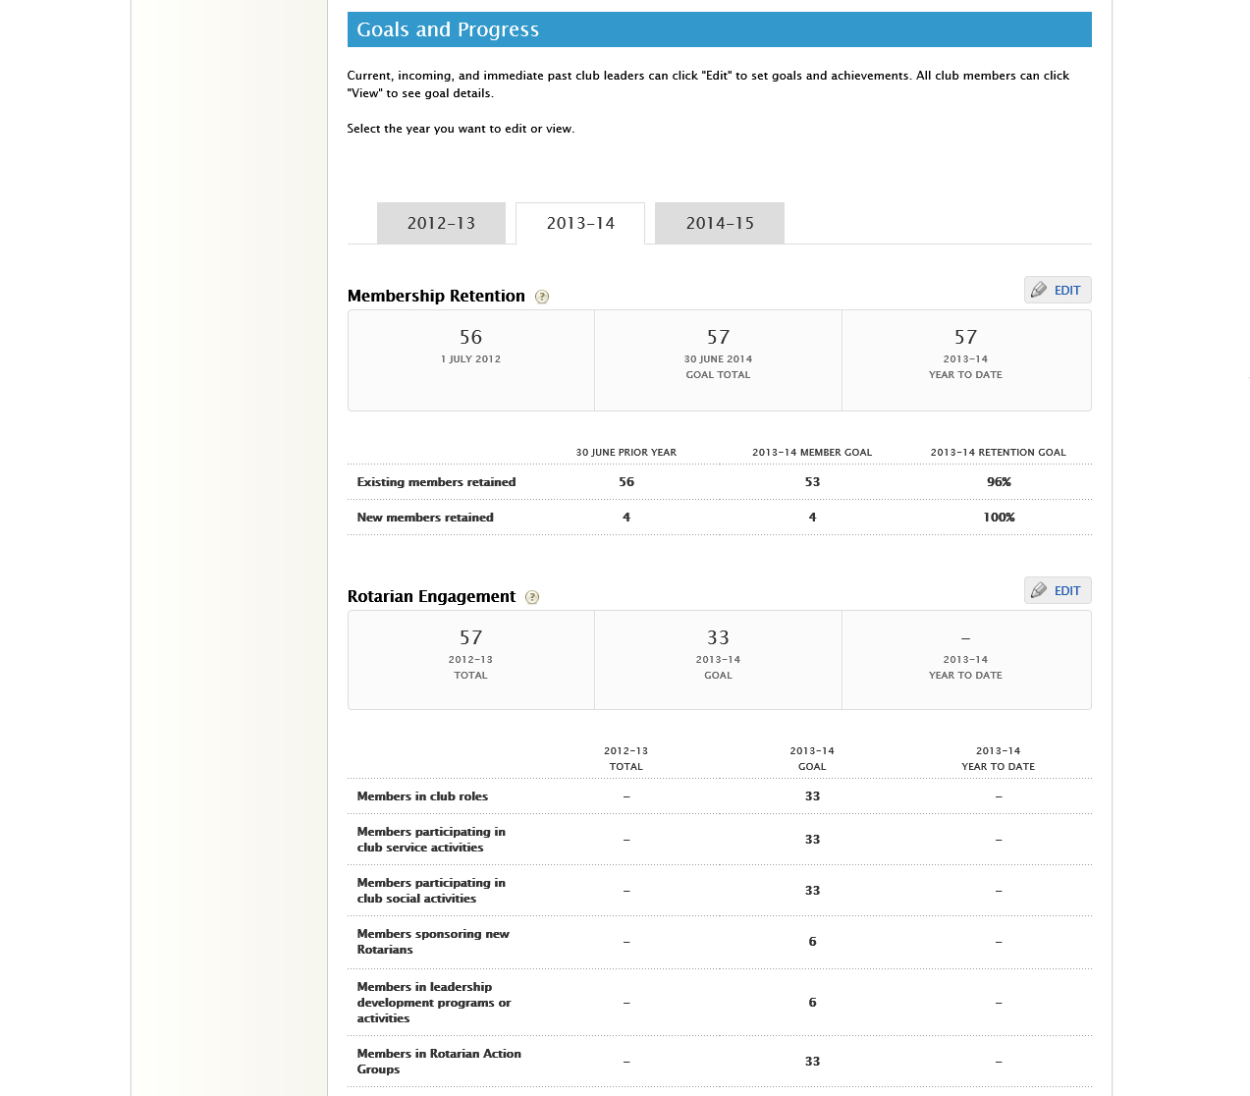
Club Goals and Progress
Membership data from RI All other goals/progress from you
Notes:
Scrolling down, we come to the Goals and Progress section. (CLICK)
Across the top are tabs for last year, the current year (which is the default) and next year. (CLICK)
Every club member can see the detail behind each section by clicking on the View button. (CLICK)
But if you’re authorized to input goals or other data, an EDIT button will appear in place of the View button. (CLICK)
In the Goals and Progress section, RI will provide membership data, but you have to input the rest. (CLICK)
Let’s go to the tab for next year and click the Edit button. (CLICK)

Slide 14
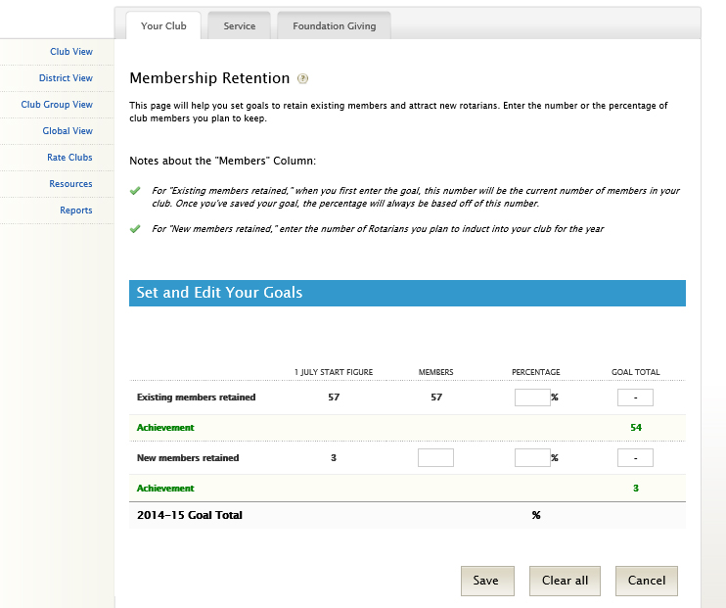
Notes:
In this Membership Retention section is where you set your membership goals for the year. (CLICK)
RI gives you your current membership and you can fill in either the percentage retention goal box or the number retained box and the system will fill in the other box for you. (CLICK)
In the New Members Retained box is where you enter your new member goal for the year (CLICK)
Then a percentage of how many of them you expect to retain (hopefully 100%). Then click the Save button to go back to the top page. (CLICK)

Slide 15
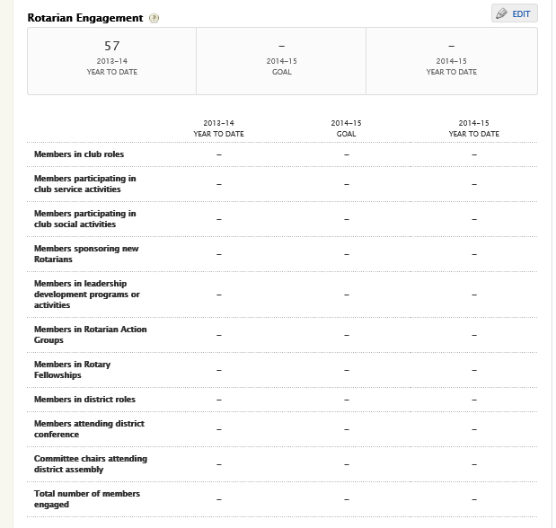
Notes:
The next Goals and Progress section is for Membership Engagement goals. Let’s click on the Edit button for this section. (CLICK)

Slide 16
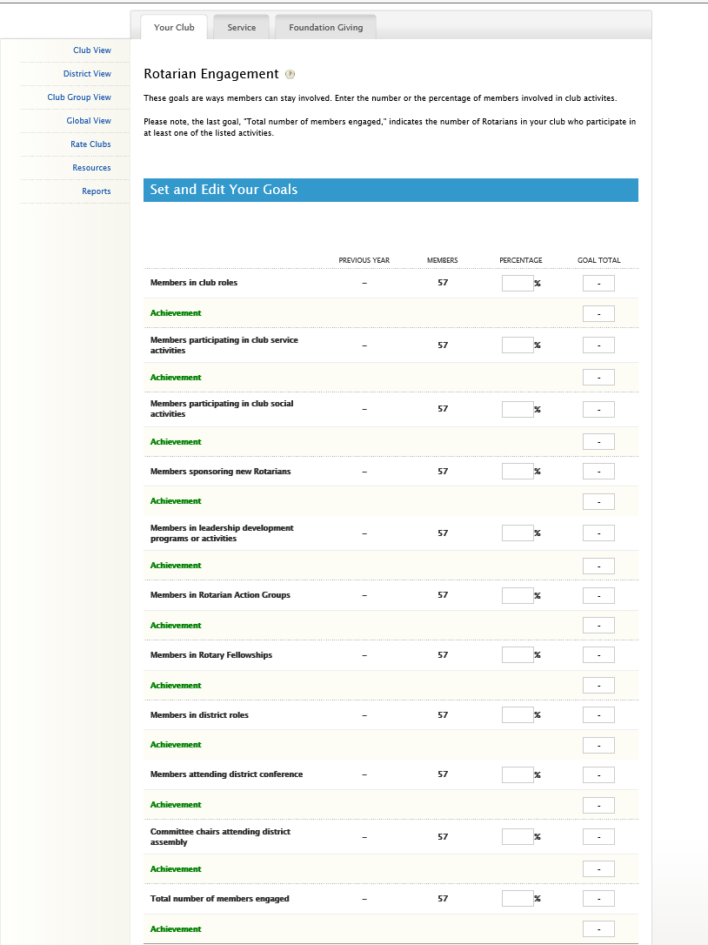
Notes:
Here again, you can fill out either the percentage or an absolute number for each category and the system will fill in the other one. (CLICK)
But, starting here is where you have to come back later and fill in what you actually accomplished in each area. Putting in the results before the end of your year is critical to your successor. You may want to sit with this year’s President to put in the results for this year so you get the idea. (CLICK)

Slide 17
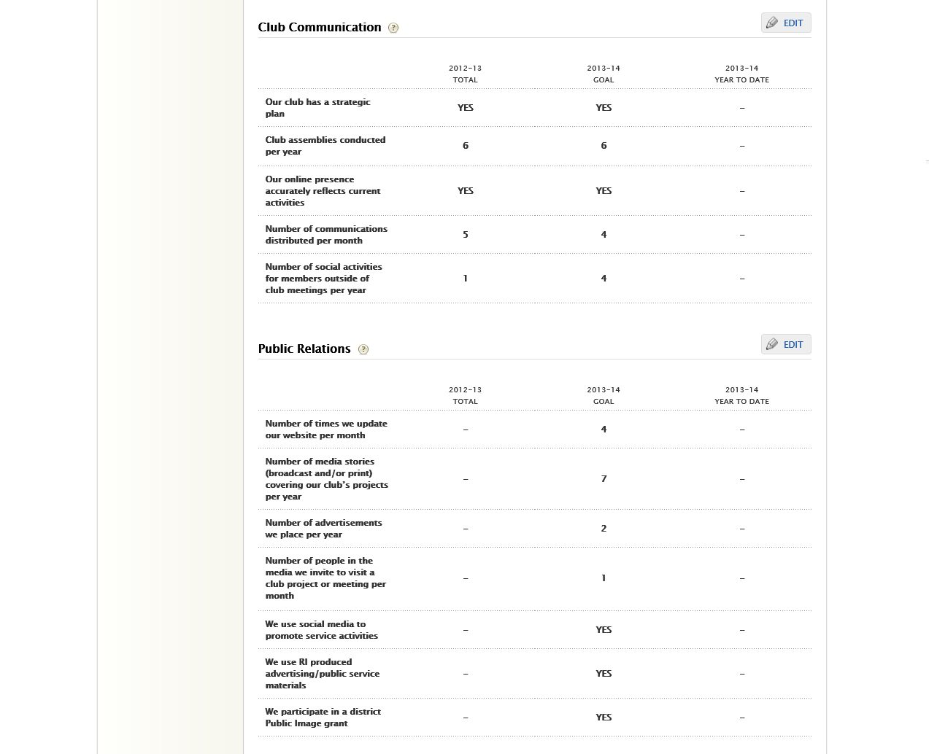
Notes:
The last two sections in the Your Club tab are for Club Communications and Public Relations. Let’s hit the Edit button for Communications. (CLICK)

Slide 18
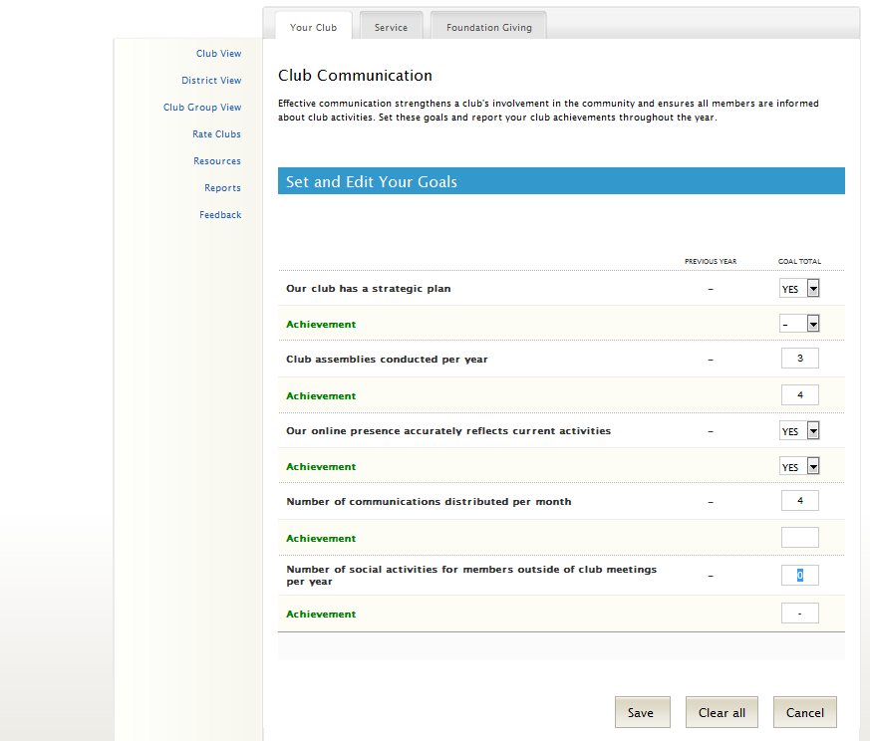
Notes:
On the Edit screen, you’ll see that different questions may have drop-down boxes (CLICK) or just places to fill in. (CLICK)
Again, though (CLICK), you’ll need to come back at some point in the future to record your progress.
(CLICK)

Slide 19
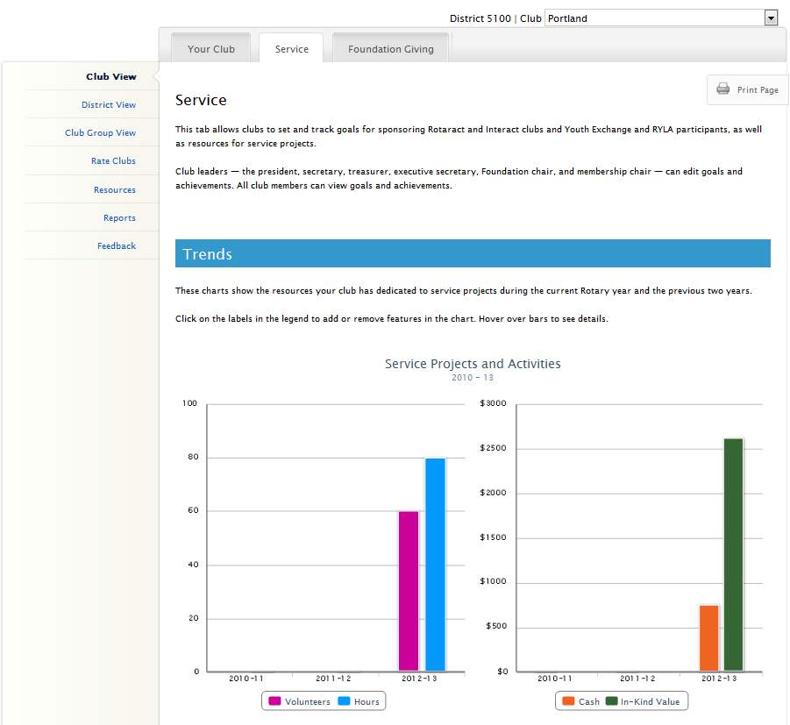
Notes:
Moving on to the Service tab, you see a trend graph with a breakdown of the impact achieved from your club’s service projects and activities over the last three years. The four impact measures are number of volunteers, total volunteer hours, cash donations, and in-kind donations. (CLICK)

Slide 20
Club View / Service Tab
Trend Data
Service Volunteers, Hours & Resources
Goals and Progress
Service Projects & Activities
New Generations Clubs & Participants
Notes:
Here’s a view of the whole Service tab. (CLICK)
At the top is the Trend data we just saw. (CLICK) (CLICK)
Then there are two sections under Goals and Progress (CLICK)
Service Projects and Activities (CLICK)
And New Generations information (CLICK)

Slide 21
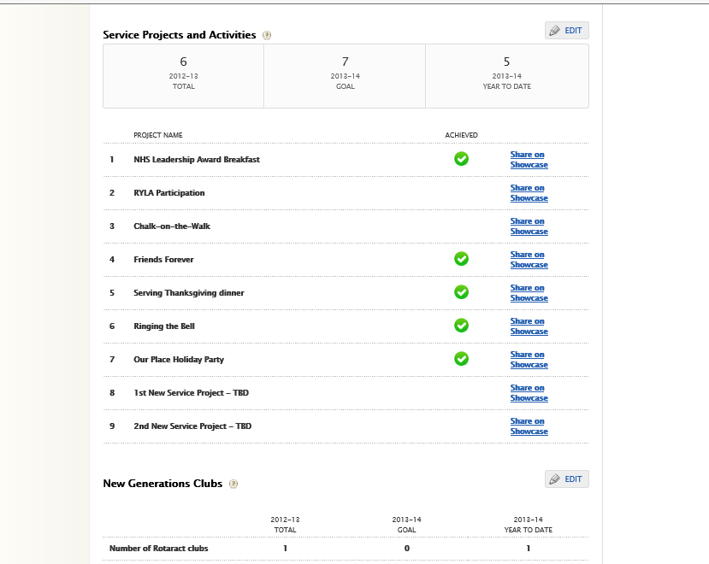
Notes:
Here is a screen that shows a number of Service Projects already created, (CLICK)
The green check mark indicates that the project has been completed. (CLICK)
Let’s hit the Edit button to see how we create this project information. (CLICK)

Slide 22
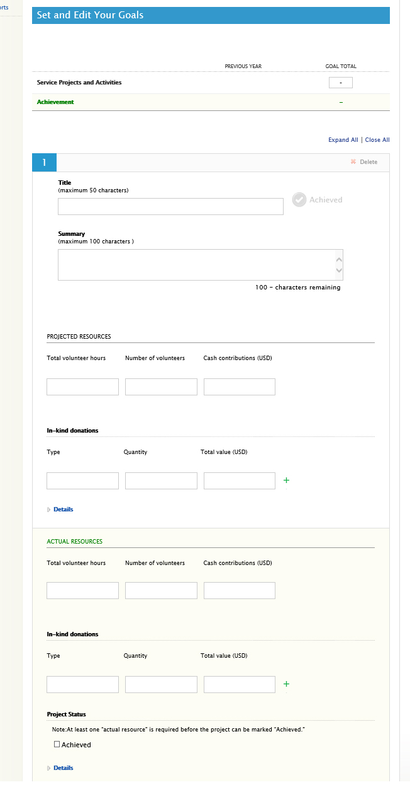
Notes:
When you set up any Project, (CLICK)
You first give it a name and a short description. (CLICK)

Slide 23
Notes:
Then you’ll need to estimate the human and financial resources the project will need. (CLICK)
When the project is completed, you’ll come back to enter the actual resources the project consumed. (CLICK)
And when you’ve done that you can click the Achieved box at the bottom – which will give you a green check box on the summary screen. (CLICK)

Slide 24
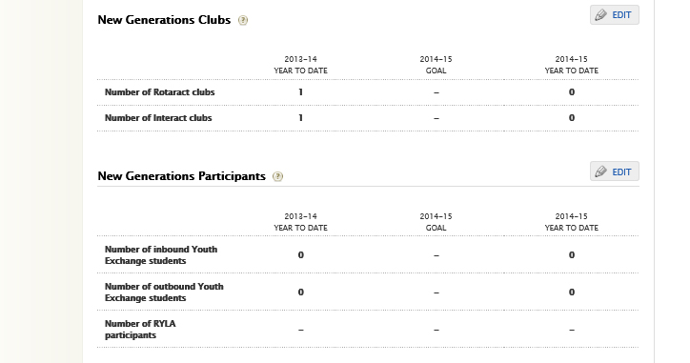
Notes:
The New Generations goals are pretty straight forward with your plans for Rotaract, Interact and Exchange students. (CLICK)

Slide 25
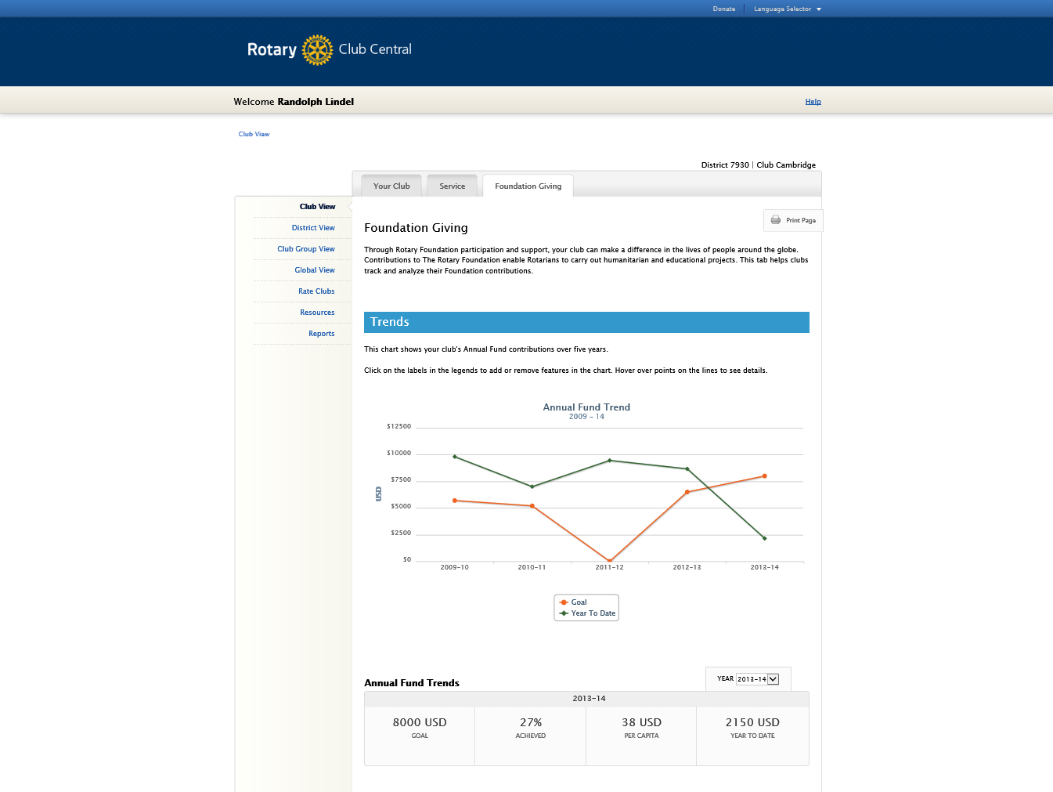
Notes:
Now, let’s move to the third and final tab for Foundation Giving. (CLICK)
Just a quick side note that you can get detailed information about the trend data by just putting your mouse over any point on a graph. (CLICK)

Slide 26
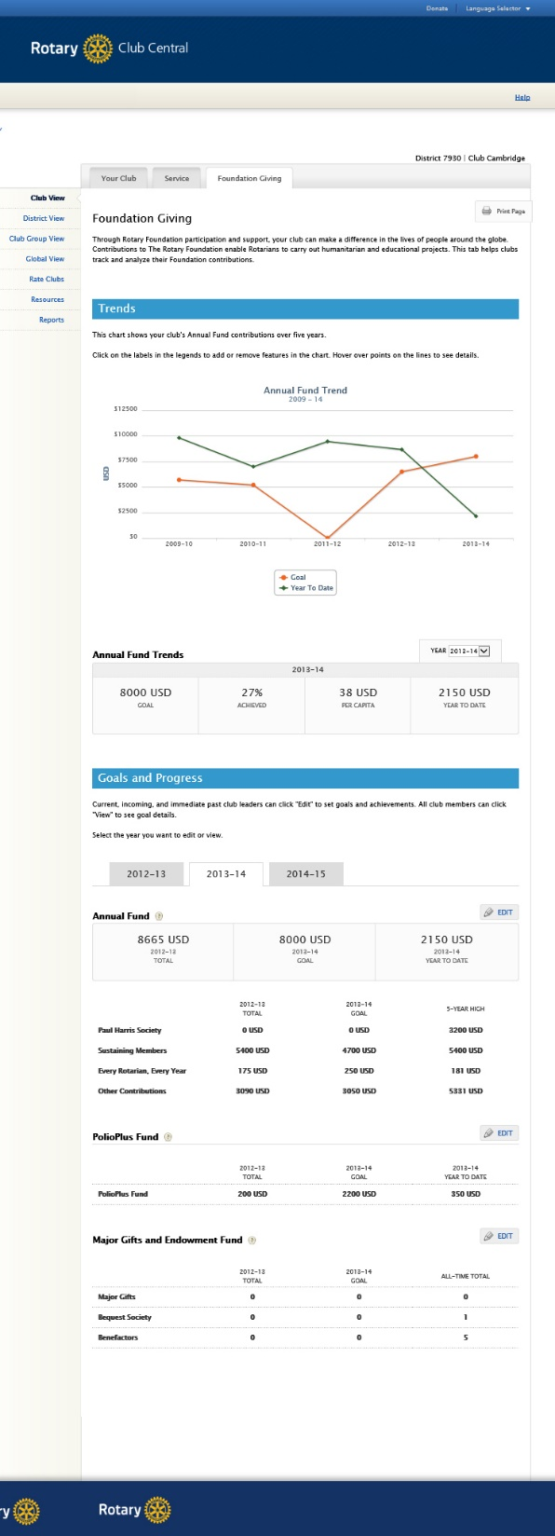
Club View / Foundation Giving Tab
Trend Data
Club total giving: 5-year goal and actual
Goals and Progress
Annual Fund: PHS, Sustaining, EREY
Polio Plus Fund
Major Gifts, Endowment Funds
Notes:
Again, here’s a look at the full Foundation Giving tab. (CLICK) (CLICK)
In the Trend section (CLICK) is a five-year track of club goals and actual giving to the Foundation. (CLICK)
Under Goals, there are sections for (CLICK) the Annual Fund, (CLICK) Polio Plus and (CLICK) Major Gifts. (CLICK)

Slide 27
791 USD
791 USD
Notes:
Let’s go to Edit the Annual Funcd section. (CLICK) (CLICK)

Slide 28
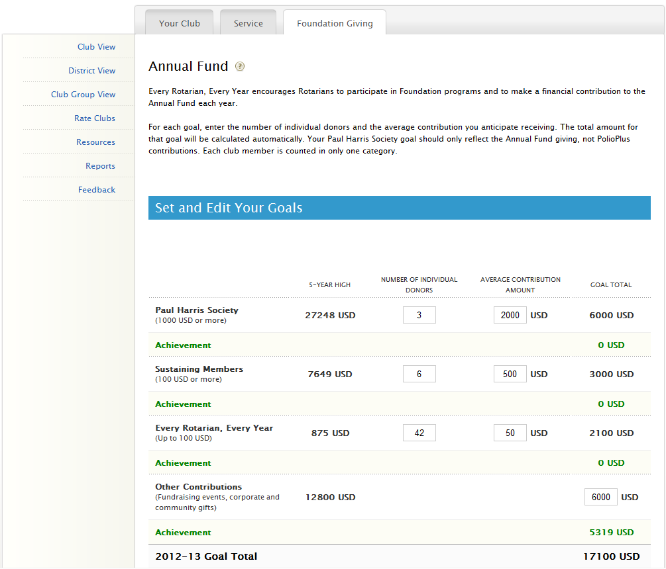
Notes:
On all the Edit pages, there are instructions to help you fill out the supporting goals. (CLICK)
In this sections, you’ll need to estimate a number of individual donors and then the average contribution amount for each goal level. As you fill in these sub-totals, you’ll see them automatically added to reflect your club’s total Annual Fund goal. (CLICK)
Underneath each sub-goal is the club’s achievement towards that goal. This is automatically populated from Rotary International’s database and does not need to be entered by the user. It is updated daily. (CLICK)
On many pages, your find little question marks in circles, which can be clicked for additional information. (CLICK)
(CLICK)

Slide 29
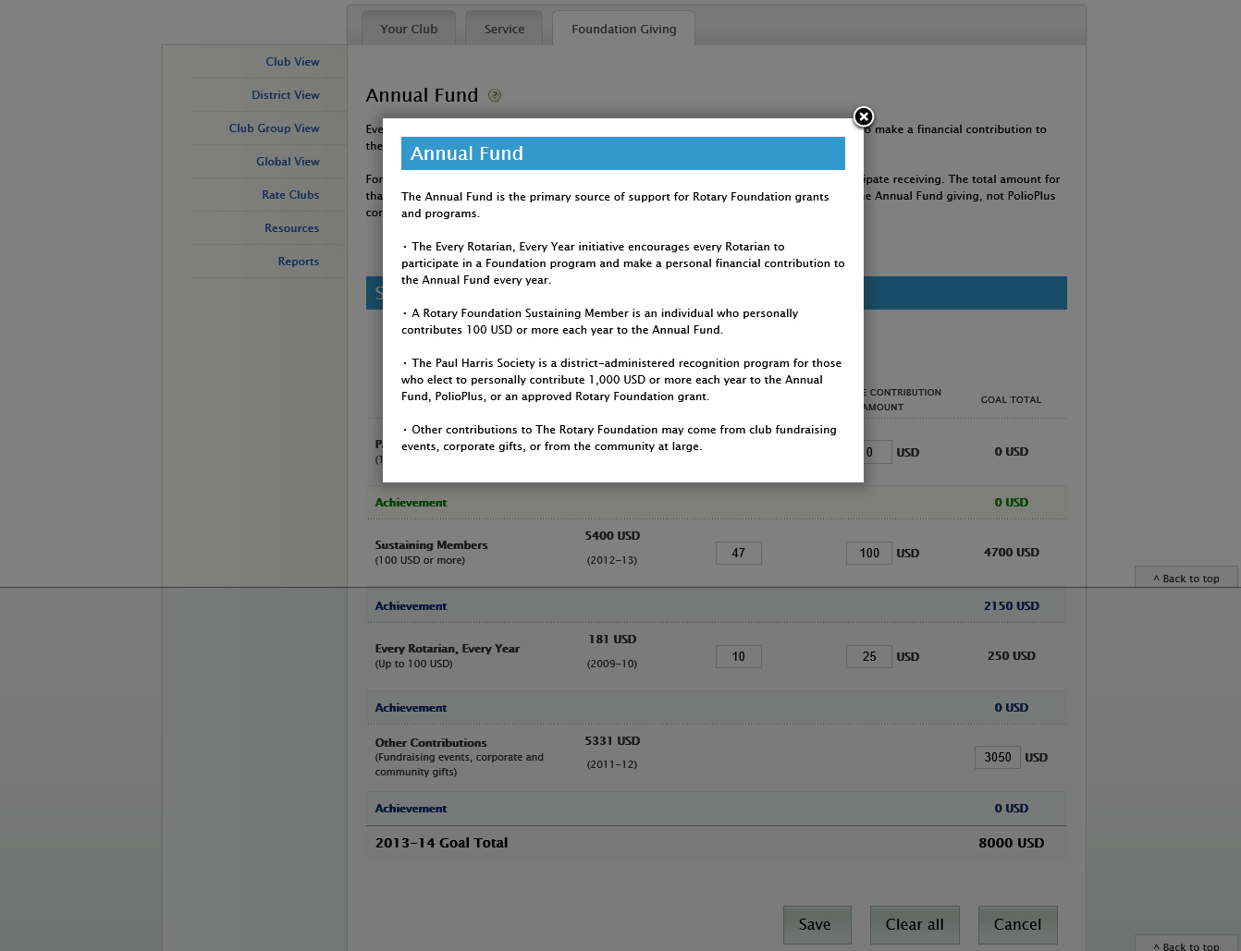

Slide 30
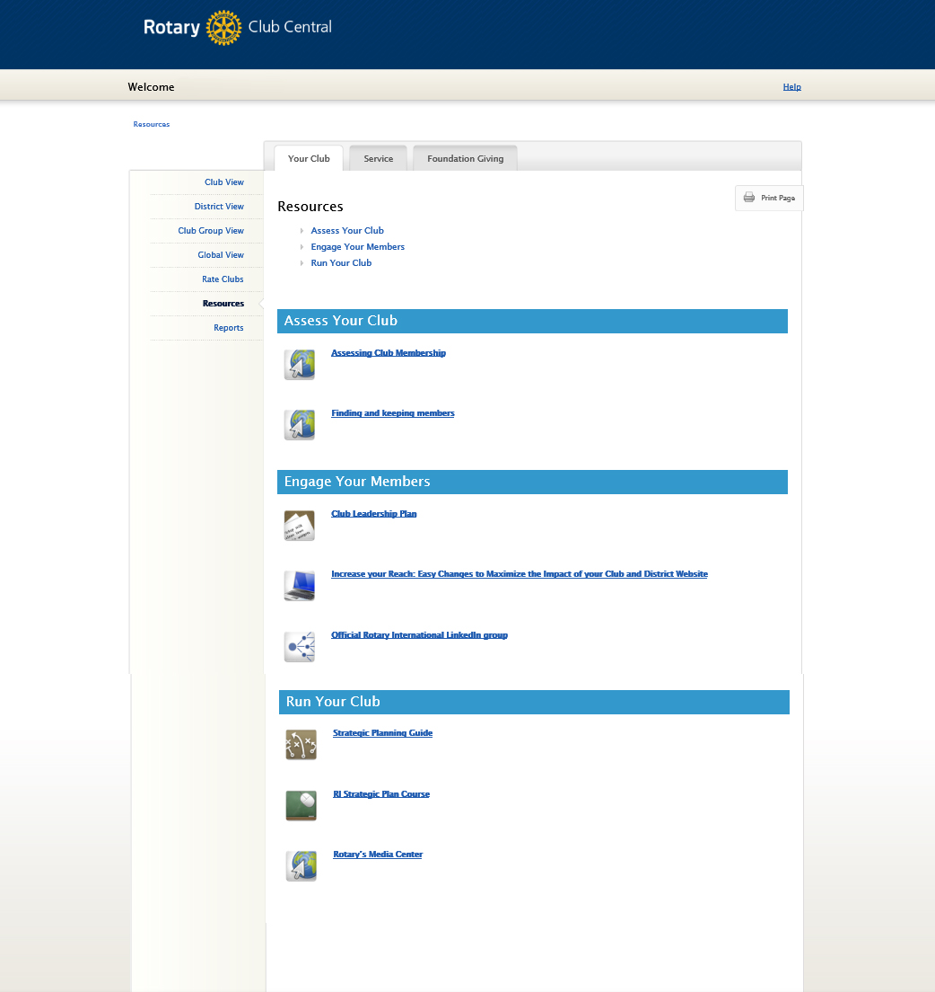
John Q. Rotarian
Notes:
Each tab has a link to resources on the left hand navigation bar. (CLICK) This will give you access to resources that can assist you in setting goals for your club. Resources include publications, links to relevant web pages, videos and much more. (CLICK)

Slide 31
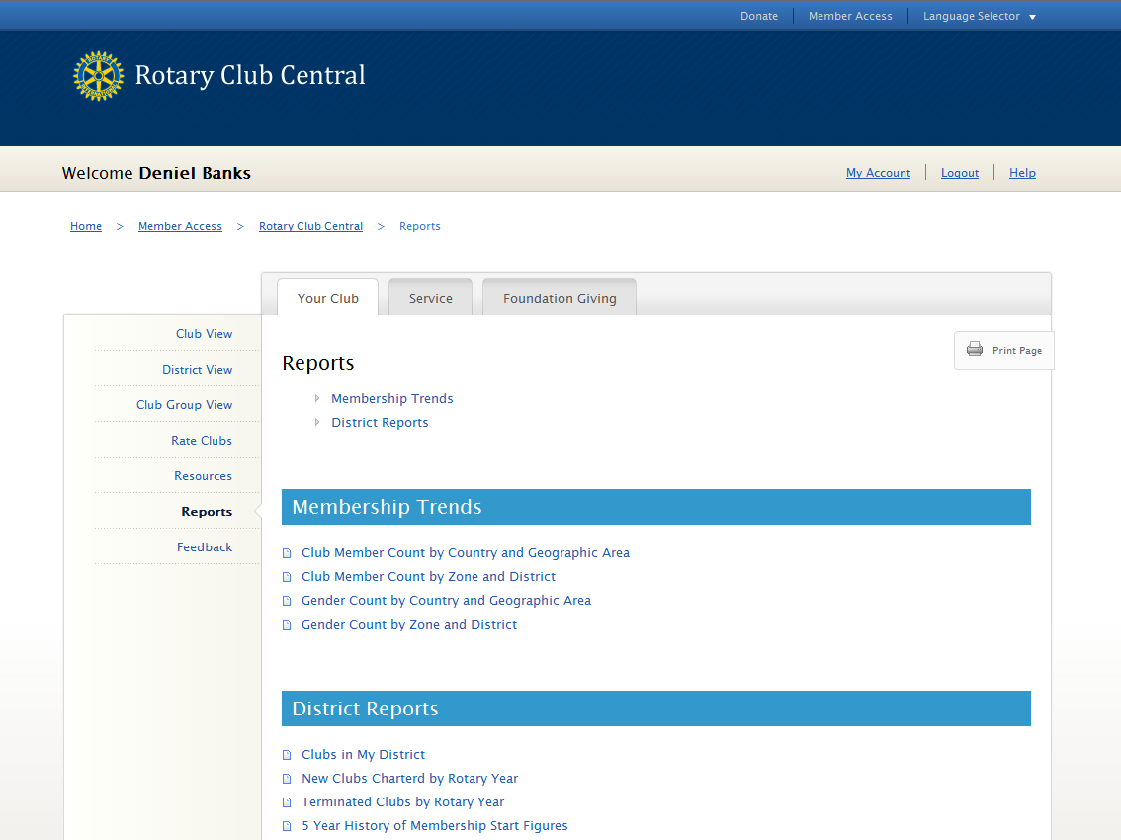
John Q. Rotarian
Notes:
Underneath the Resources link, you will find a section with reports you can view and download that are related to each of the three tabs. The reports you see will vary depending on your role in your club or district. (CLICK)

Slide 32
Notes:
So that’s the overview. If you need more information or help with Club Central, check in with your Assistant Governor or contact the District 7930 support team: Randy Lindel (rlindel@cambridgerotary.org) and Bob Wicks (bwicks2@verizon.net).
Good luck.

